Slide 1
Dijkstra’s Algorithm
Given a graph and a source vertex in the graph, find the shortest paths from the source to all vertices in the given graph.
Dijkstra's Algorithm works on the basis that any subpath B -> D of the shortest path A -> D between vertices A and D is also the shortest path between vertices B and D.
Djikstra used this property in the opposite direction i.e we overestimate the distance of each vertex from the starting vertex. Then we visit each node and its neighbors to find the shortest subpath to those neighbors.

Slide 2
function dijkstra(G, S)
for each vertex V in G
distance[V] <- infinite
previous[V] <- NULL
If V != S, add V to Priority Queue Q
distance[S] <- 0
while Q IS NOT EMPTY
U <- Extract MIN from Q
for each unvisited neighbour V of U
tempDistance <- distance[U] + edge_weight(U, V)
if tempDistance < distance[V]
distance[V] <- tempDistance
previous[V] <- U
return distance[], previous[]

Slide 3
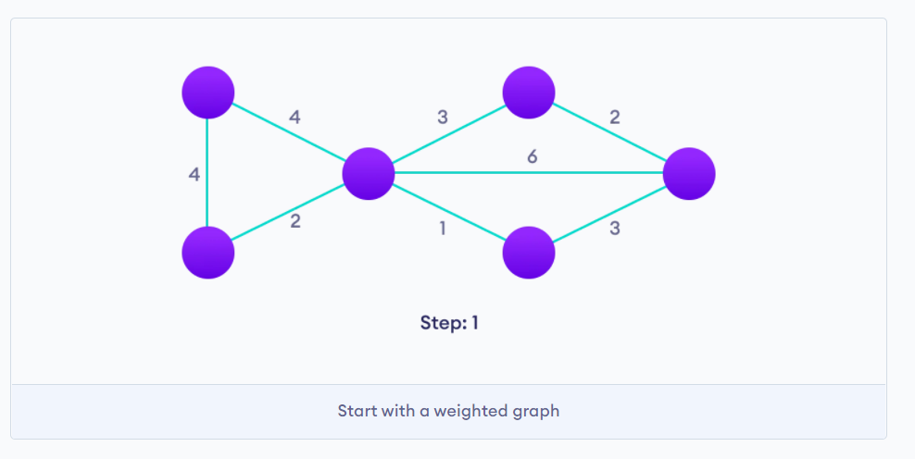

Slide 4
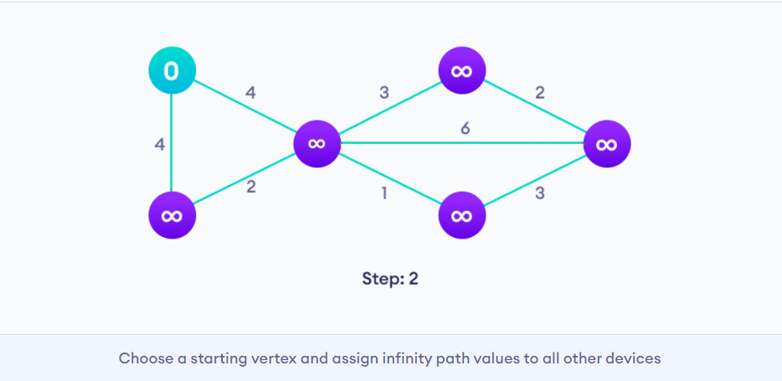

Slide 5
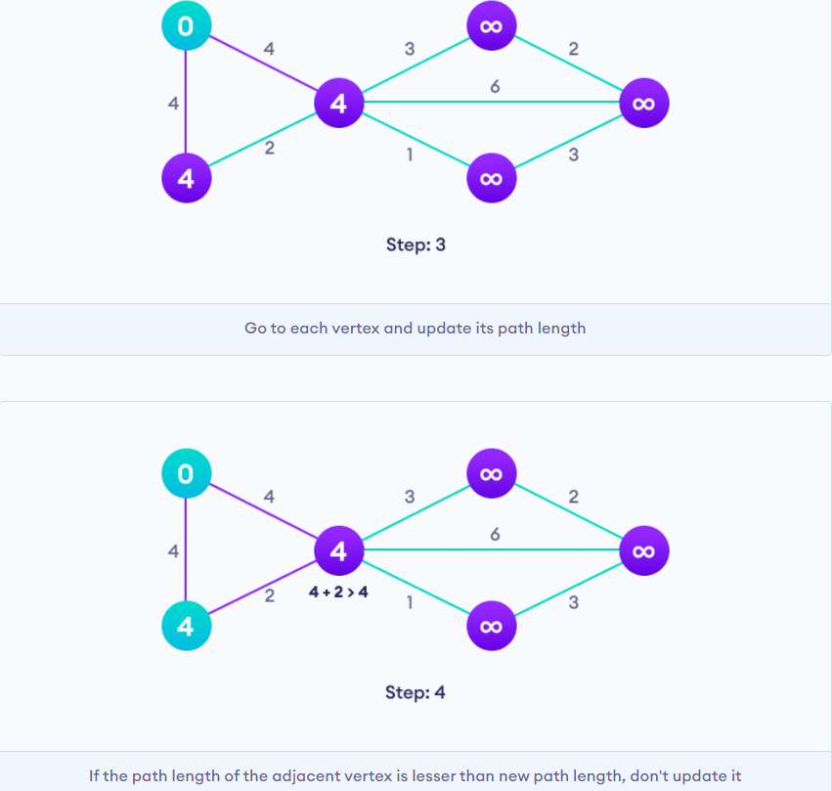

Slide 6
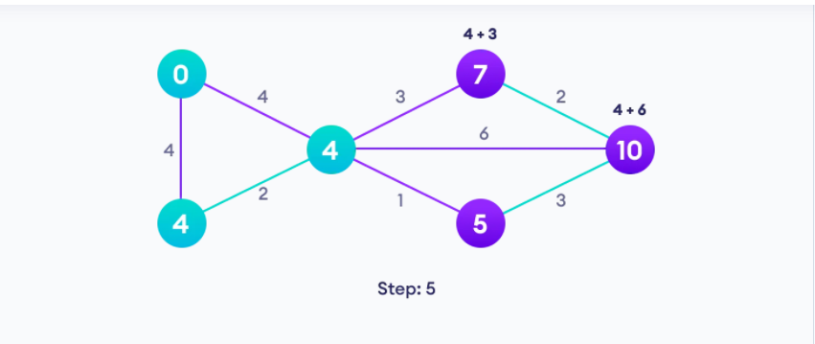
-

Slide 7
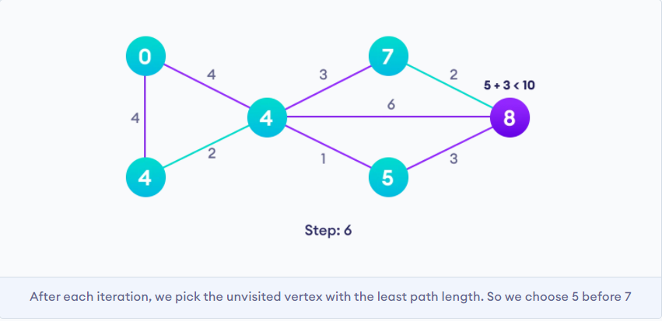

Slide 8
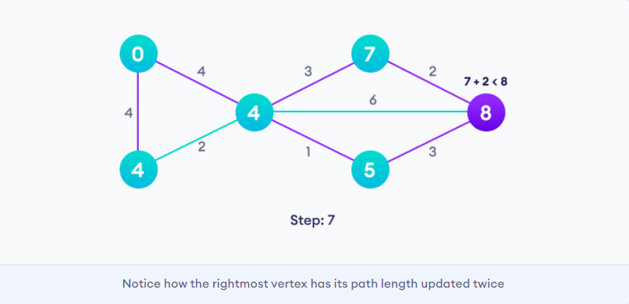

Slide 9
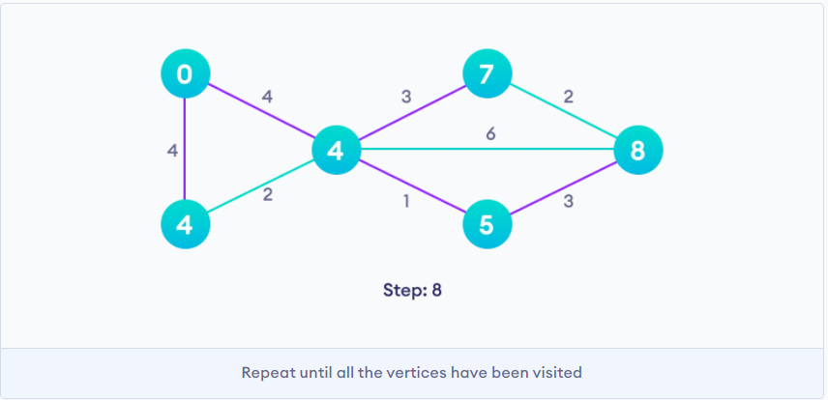

Slide 10
Dijkstra's Algorithm Complexity
Time Complexity: O(E Log V)
where, E is the number of edges and V is the number of vertices.
Space Complexity: O(V)
Dijkstra's Algorithm Applications
To find the shortest path
In social networking applications
In a telephone network
To find the locations in the map

